Slide 1
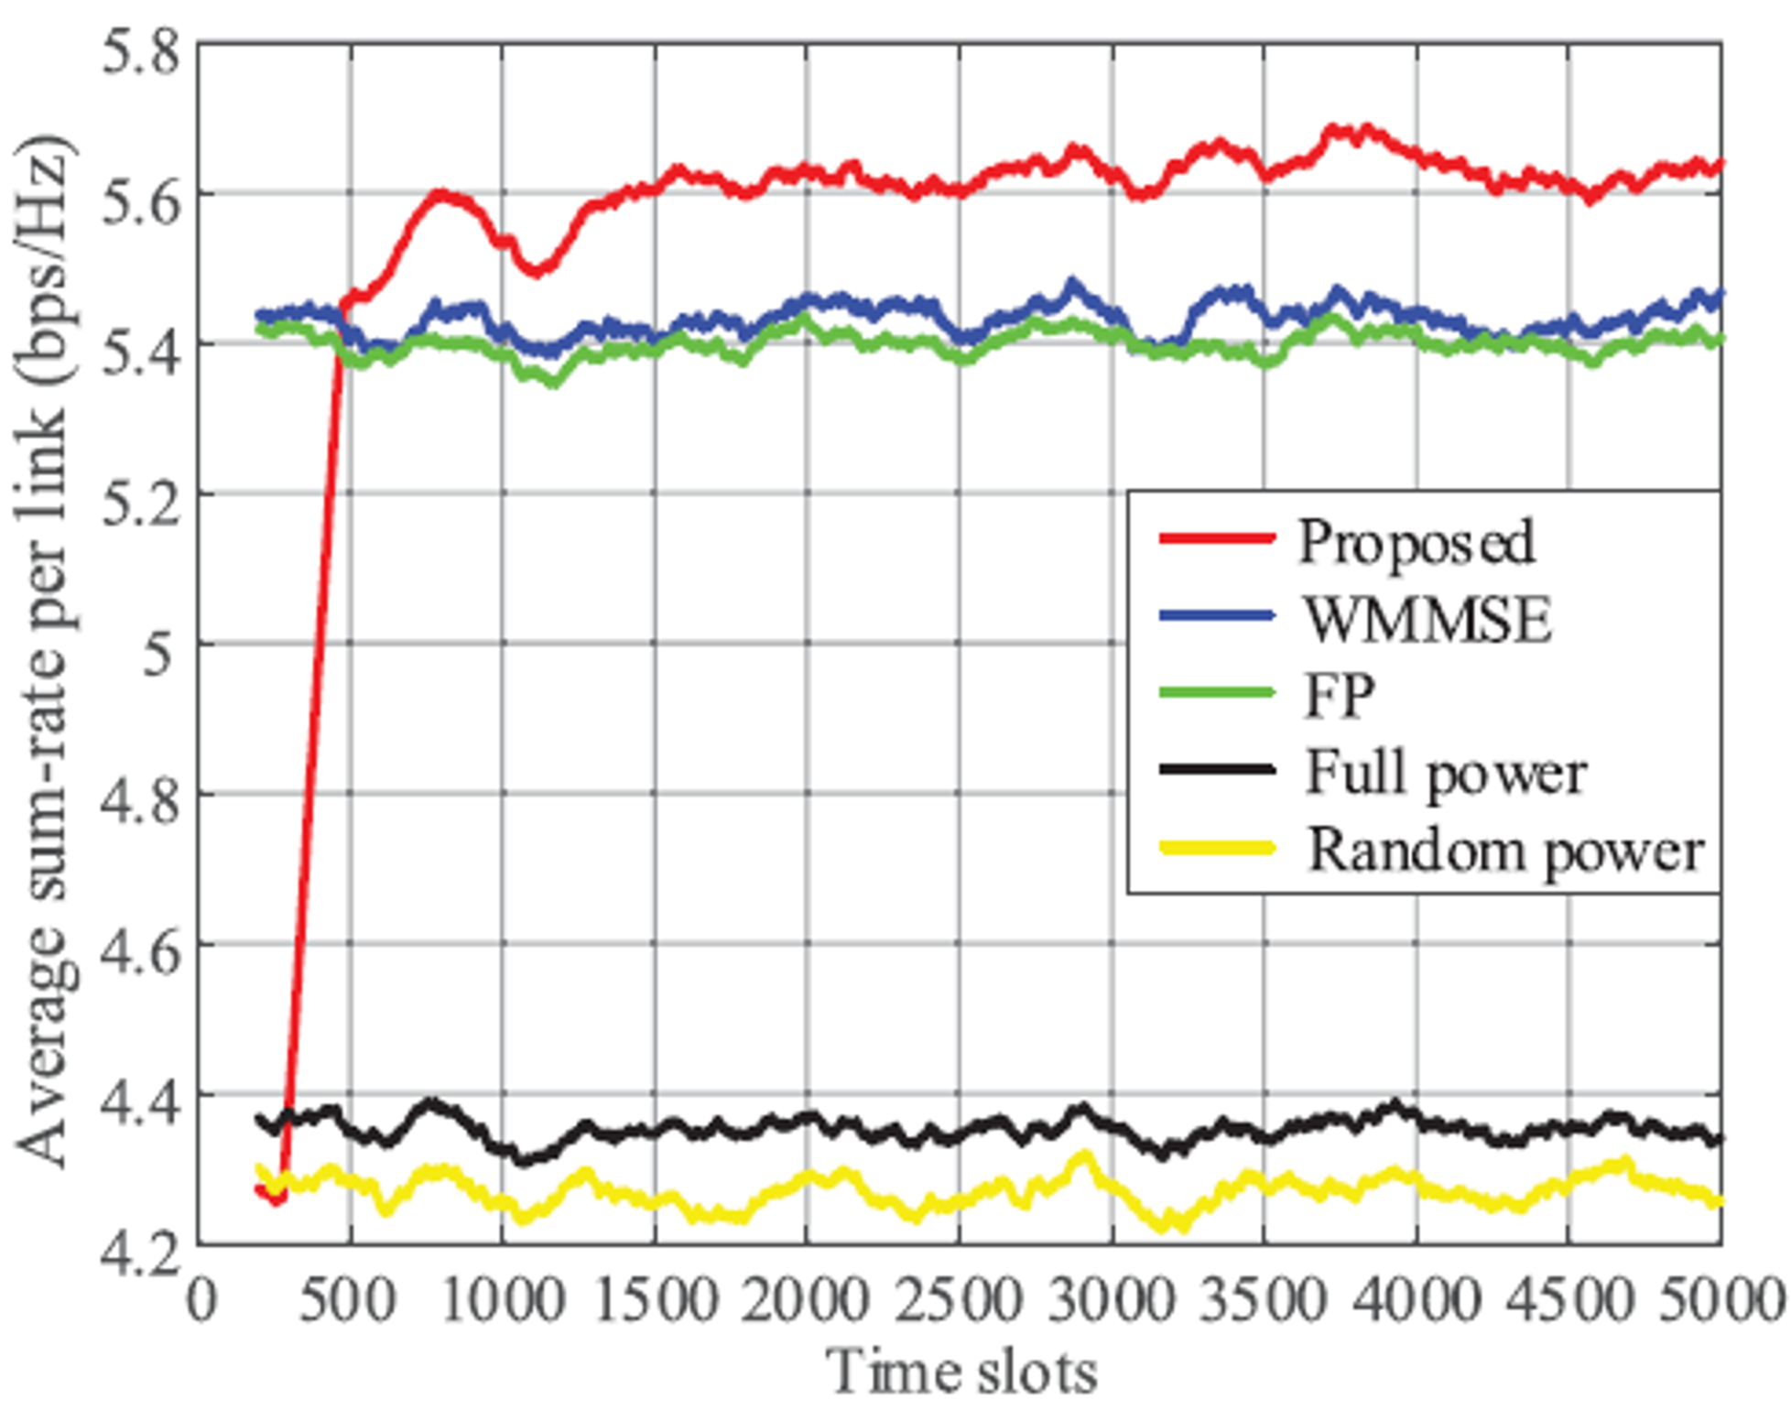
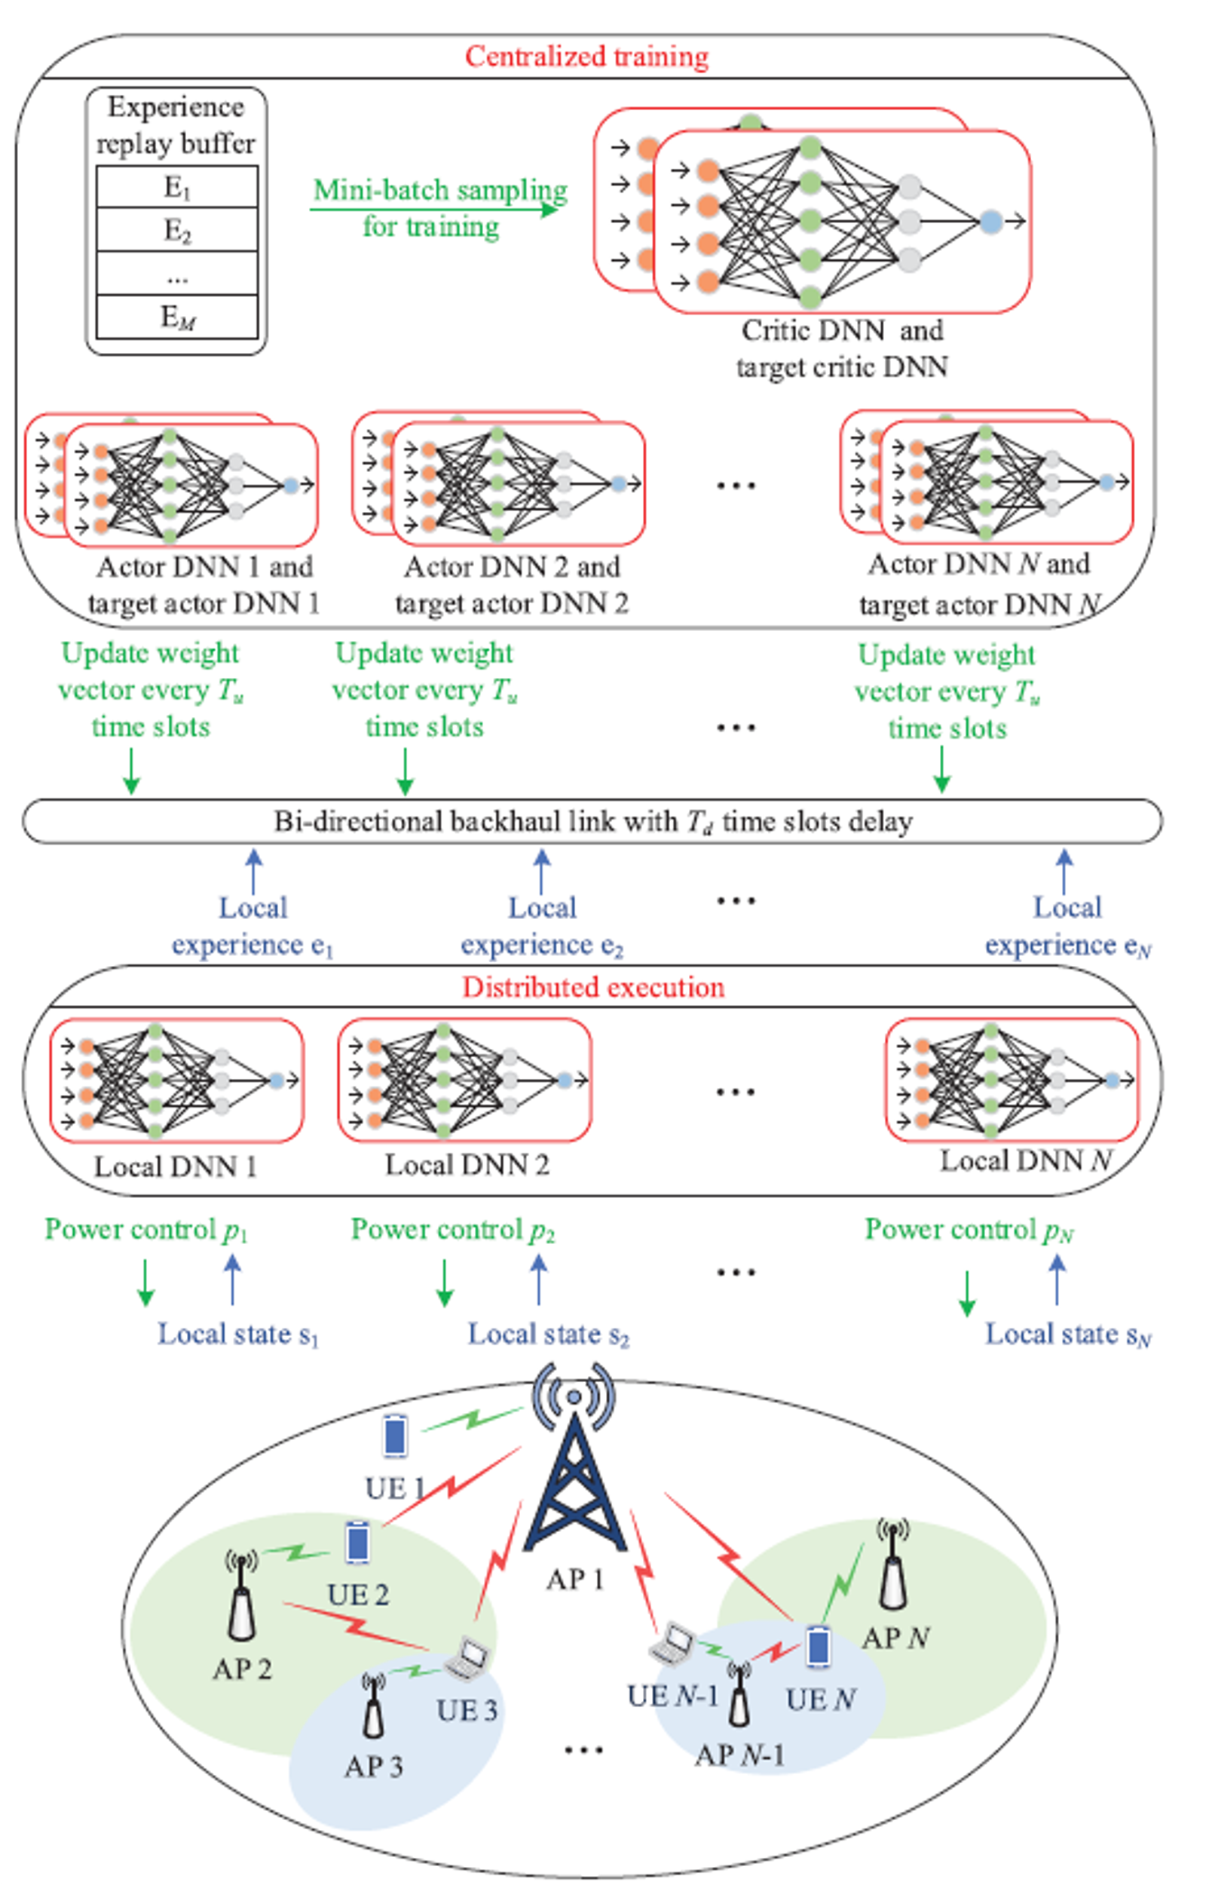
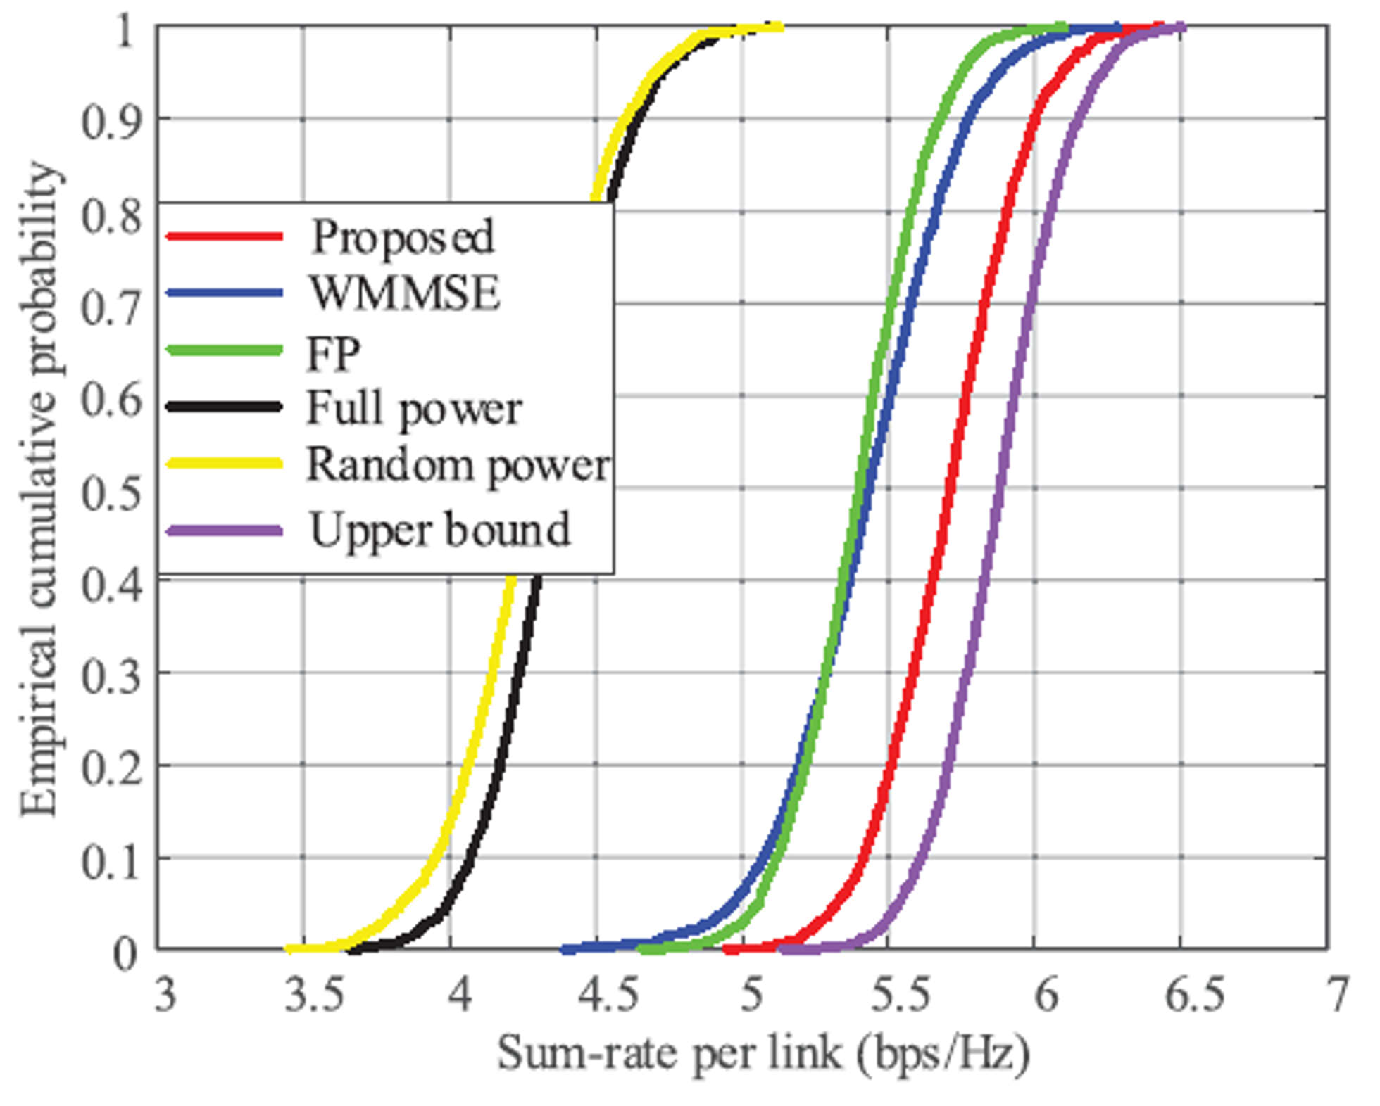
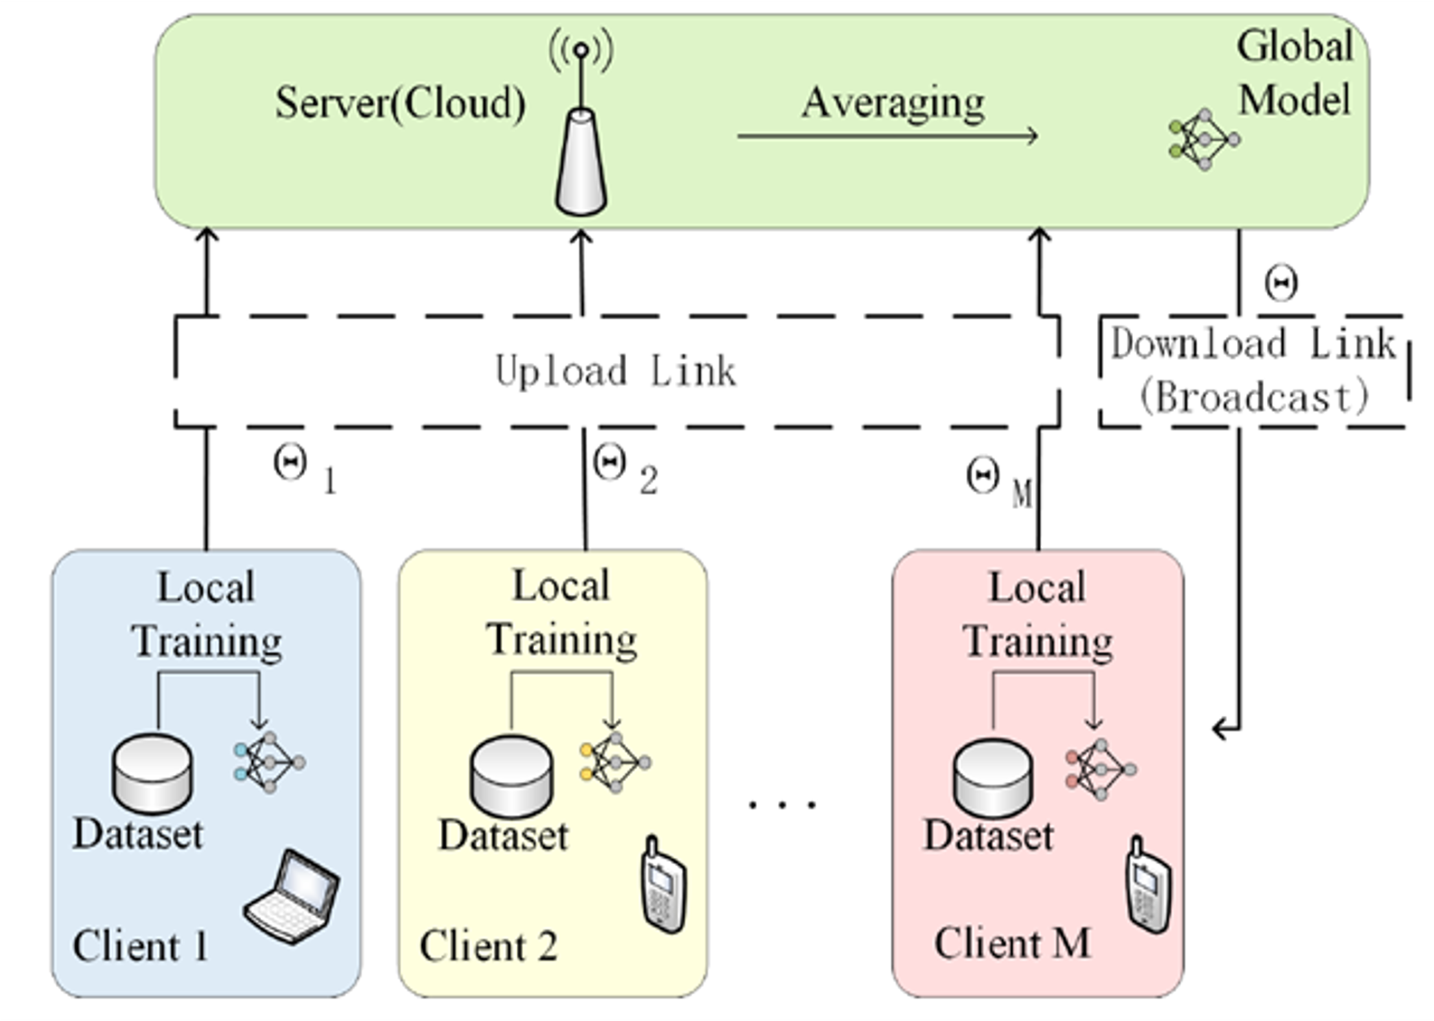
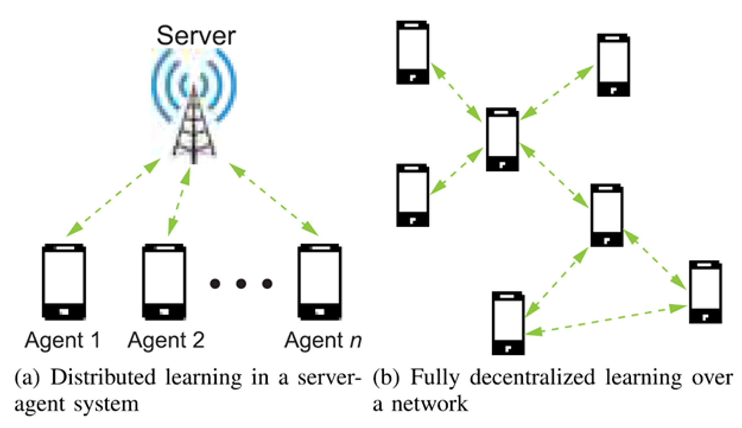
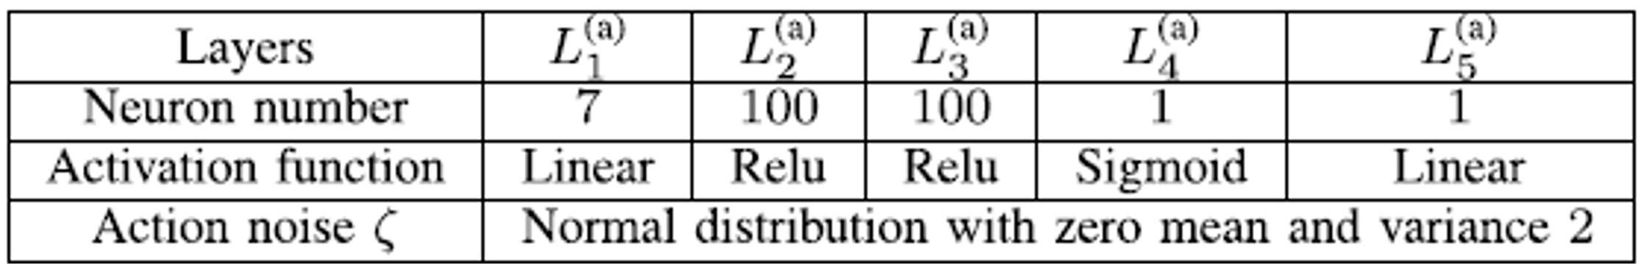
Communication-Efficient Distributed Learning
Zavareh Bozorgasl and Hao Chen
Department of Electrical and Computer Engineering
zavarehbozorgasl@u.boisestate.edu, haochen@boisestate.edu
Introduction
Our research focuses on collaborative efforts to train machine learning models without the need to centralize raw data. This approach not only reduces the computational burden on central processors but also bolsters data privacy. Due to iterative information exchange across wireless channels, it’s an urgent need for communication-efficient distributed learning algorithms that aim to cut down communication costs while still achieving robust learning and optimization outcomes​.
Background and Preliminaries: The framework and architecture of distributed learning systems, highlighting the role of intelligent agents and central processors.
Challenges in Communication: High communication requirements for iterative information exchange; limitations imposed by energy and bandwidth resources
Methods to Deal with the Challenges: Communication-Efficient Strategies: Efficient Strategies with Machine (Deep) (Reinforcement) Learning Models
Research goal: Advanced power control to manage the interference and enhance the sum-rate of the whole network with deep reinforcement learning (DRL) with centralized-training-distributed-execution
Different Learning Paradigms are Combined to Achieve Efficiency
Federated Learning
Employing MARL
(Multi-Agent Reinforcement Learning)
for Power Control in
Heterogeneous Networks (HetNets)
Simulation Results
Federated Learning (FL) is a machine learning setting designed to train algorithms across multiple decentralized edge devices or servers (clients) holding local data samples, without exchanging them:
Decentralized Data: reducing privacy risks and data centralization concerns
Privacy Enhancement: addressing significant privacy and security concerns
Communication Efficiency: quantized Neural Networks (Binary, Ternary, Mixed-Precision Neural Networks)
Model Aggregation
Parameters:
Two-layer HetNet
Five APs
Each AP has a disc service coverage
maximum transmit power of AP 1 in the first layer is 30 dBm
maximum transmit power of
each AP in the second layer is 23 dBm
The served UE by an AP is randomly located within the service coverage of the AP.
Results (simulations, tables and MARL) are taken from [3]
Distributed Learning Paradigms
Hyper –parameters of each local Deep Neural Network (DNN).
Hyper –parameters of the critic Deep Neural Network (DNN).
Challenges and Solutions
Data Heterogeneity: non-IID (Independent and Identically Distributed) data; Techniques like personalized federated learning and meta-learning
Scalability and Efficiency: Handling thousands to millions of devices, each with potentially different computational and communication capabilities; Adaptive learning and client selection strategies
Security Concerns: vulnerable to attacks, such as model poisoning and inference attacks; Robust aggregation algorithms, differential privacy, and secure multi-party computation techniques
Applying Deep Q-network (DQN) and Deep Deterministic Policy Gradient (DDPG) algorithms, explaining how these DRL techniques can be applied to solve sequential decision-making problems in wireless networks
Centralized-training-distributed-execution architecture
Multiple-actor-shared-critic (MASC) training method
Enabling Access points (Aps) to independently optimize transmit power to enhance network sum-rate without needing global CSI.
Conclusion and Future Work
Role of communication efficiency in enabling distributed learning algorithms to achieve satisfactory learning and optimization performance while mitigating the burden on limited communication resources.
Future works: Employing compression techniques (like quantization and sparsification) and proposing methods for user selection in federated learning; Efficient radio resource management in dynamic and heterogeneous networks; Privacy and security in in federated learning
References:
X. Cao, T. Ba, S. Diggavi, Y. C. Eldar, K. B. Letaief, H. V. Poor, and J. Zhang, "Communication-efficient distributed learning: An overview," IEEE Journal on Selected Areas in Communications, 2023.
H. B. McMahan, E. Moore, D. Ramage, and B. Agüera y Arcas, "Federated learning of deep networks using model averaging," arXiv preprint arXiv:1602.05629, vol. 2, no. 2, 2016.
L. Zhang and Y.-C. Liang, "Deep reinforcement learning for multiagent power control in heterogeneous networks," IEEE Transactions on Wireless Communications, vol. 20, no. 4, pp. 2551–2564, 2020.

